Slide 1
COMP 2710 Software Construction
Function Templates
Class Templates
Stacks
Vectors
Dr. Alvin Lim
Auburn University
http://www.eng.auburn.edu/~lim
limalvi@auburn.edu
Fall 2014

Slide 2
Learning Objectives
Function Templates
  Syntax, defining
  Compiler complications
Class Templates
  Syntax
  Example: array template class
Copyright © 2010 Pearson Addison-Wesley. All rights reserved.
16-<number>

Slide 3
Introduction
C++ templates
  Allow very "general" definitions for functions and classes
  Type names are "parameters" instead of
  actual types
  Precise definition determined at run-time
Copyright © 2010 Pearson Addison-Wesley. All rights reserved.
16-<number>

Slide 4
Function Templates
Recall function swapValues:
void swapValues(int& var1, int& var2)
{
int temp;
temp = var1;
var1 = var2;
var2 = temp;
}
Applies only to variables of type int
But code would work for any types!
Copyright © 2010 Pearson Addison-Wesley. All rights reserved.
16-<number>

Slide 5
Function Templates vs. Overloading
Could overload function for char’s:
void swapValues(char& var1, char& var2)
{
char temp;
temp = var1;
var1 = var2;
var2 = temp;
}
But notice: code is nearly identical!
  Only difference is type used in 3 places
16-<number>
Copyright © 2010 Pearson Addison-Wesley. All rights reserved.

Slide 6
Function Template Syntax
Allow "swap values" of any type variables:
template<class T>
void swapValues(T& var1, T& var2)
{
T temp;
temp = var1;
var1 = var2;
var2 = temp;
}
First line called "template prefix"
  Tells compiler what’s coming is "template"
  And that T is a type parameter
Copyright © 2010 Pearson Addison-Wesley. All rights reserved.
16-<number>

Slide 7
Template Prefix
Recall:
template<class T>
In this usage, "class" means "type", or
"classification"
Can be confused with other "known" use
of word "class"!
  C++ allows keyword "typename" in place of
  keyword "class" here
  But most use "class" anyway
16-<number>
Copyright © 2010 Pearson Addison-Wesley. All rights reserved.

Slide 8
Template Prefix 2
Again:
template<class T>
T can be replaced by any type
  Predefined or user-defined (like a C++ class type)
In function definition body:
  T used like any other type
Note: can use other than "T", but T is
"traditional" usage
Copyright © 2010 Pearson Addison-Wesley. All rights reserved.
16-<number>

Slide 9
Function Template Definition
swapValues() function template is actually
large "collection" of definitions!
  A definition for each possible type!
Compiler only generates definitions when
required
  But it’s "as if" you’d defined for all types
Write one definition → works for all types
that might be needed
Copyright © 2010 Pearson Addison-Wesley. All rights reserved.
16-<number>

Slide 10
Calling a Function Template
Consider following call:
swapValues(int1, int2);
  C++ compiler "generates" function definition for two int parameters
  using template
Likewise for all other types
Needn’t do anything "special" in call
  Required definition automatically generated
Copyright © 2010 Pearson Addison-Wesley. All rights reserved.
16-<number>

Slide 11
Another Function Template
Declaration/prototype:
Template<class T>
void showStuff(int stuff1, T stuff2, T stuff3);
Definition:
template<class T>
void showStuff(int stuff1, T stuff2, T stuff3)
{
cout << stuff1 << endl
<< stuff2 << endl
<< stuff3 << endl;
}
Copyright © 2010 Pearson Addison-Wesley. All rights reserved.
16-<number>

Slide 12
showStuff Call
Consider function call:
showStuff(2, 3.3, 4.4);
Compiler generates function definition
  Replaces T with double
    Since second parameter is type double
Displays:
2
3.3
4.4
Copyright © 2010 Pearson Addison-Wesley. All rights reserved.
16-<number>

Slide 13
Compiler Complications
Function declarations and definitions
  Typically we have them separate
  For templates → not supported on
  most compilers!
Safest to place template function
definition in file where invoked
  Many compilers require it appear 1st
  Often we #include all template definitions
Copyright © 2010 Pearson Addison-Wesley. All rights reserved.
16-<number>

Slide 14
Algorithm Abstraction
Refers to implementing templates
Express algorithms in "general" way:
  Algorithm applies to variables of any type
  Ignore incidental detail
  Concentrate on substantive parts
  of algorithm
Function templates are one way C++
supports algorithm abstraction
Copyright © 2010 Pearson Addison-Wesley. All rights reserved.
16-<number>

Slide 15
Inappropriate Types in Templates
Can use any type in template for which
code makes "sense"
  Code must behave in appropriate way
e.g., swapValues() template function
  Cannot use type for which assignment operator isn’t defined
  Example: an array:
  int a[10], b[10];
  swapValues(a, b);
    Arrays cannot be "assigned"!
16-<number>
Copyright © 2010 Pearson Addison-Wesley. All rights reserved.

Slide 16
Class Templates
Can also "generalize" classes
template<class T>
  Can also apply to class definition
  All instances of "T" in class definition replaced by type parameter
  Just like for function templates!
Once template defined, can declare
objects of the class
Copyright © 2010 Pearson Addison-Wesley. All rights reserved.
16-<number>

Slide 17
Class Template Definition
template<class T>
class Pair
{
public:
Pair();
Pair(T firstVal, T secondVal);
void setFirst(T newVal);
void setSecond(T newVal);
T getFirst() const;
T getSecond() const;
private:
T first; T second;
};
Copyright © 2010 Pearson Addison-Wesley. All rights reserved.
16-<number>

Slide 18
Template Class Pair Members
template<class T>
Pair<T>::Pair(T firstVal, T secondVal)
{
first = firstVal;
second = secondVal;
}
template<class T>
void Pair<T>::setFirst(T newVal)
{
first = newVal;
}
Copyright © 2010 Pearson Addison-Wesley. All rights reserved.
16-<number>

Slide 19
Template Class Pair
Objects of class have "pair" of values of
type T
Can then declare objects:
Pair<int> score;
Pair<char> seats;
  Objects then used like any other objects
Example uses:
score.setFirst(3);
score.setSecond(0);
16-<number>
Copyright © 2010 Pearson Addison-Wesley. All rights reserved.

Slide 20
Pair Member Function Definitions
Notice in member function definitions:
  Each definition is itself a "template"
  Requires template prefix before
  each definition
  Class name before :: is "Pair<T>"
    Not just "Pair"
  But constructor name is just "Pair"
  Destructor name is also just "~Pair"
Copyright © 2010 Pearson Addison-Wesley. All rights reserved.
16-<number>

Slide 21
Class Templates as Parameters
Consider:
int addUP(const Pair<int>& thePair);
  The type (int) is supplied to be used for T
  in defining this class type parameter
  It "happens" to be call-by-reference here
Again: template types can be used
anywhere standard types can
16-<number>
Copyright © 2010 Pearson Addison-Wesley. All rights reserved.

Slide 22
Class Templates
Within Function Templates
Rather than defining new overload:
template<class T>
T addUp(const Pair<T>& thePair);
//Precondition: Operator + is defined for values
of type T
//Returns sum of two values in thePair
Function now applies to all kinds
of numbers
16-<number>
Copyright © 2010 Pearson Addison-Wesley. All rights reserved.

Slide 23
Restrictions on Type Parameter
Only "reasonable" types can be substituted
for T
Consider:
  Assignment operator must be "well-behaved"
  Copy constructor must also work
  If T involves pointers, then destructor must
  be suitable!
Similar issues as function templates
16-<number>
Copyright © 2010 Pearson Addison-Wesley. All rights reserved.

Slide 24
Predefined Template Classes
vector class
  It’s a template class!
Another: basic_string template class
  Deals with strings of "any-type" elements
  e.g.,
basic_string<char> works for char’s
basic_string<double> works for doubles
basic_string<YourClass> works for
YourClass objects
Copyright © 2010 Pearson Addison-Wesley. All rights reserved.
16-<number>

Slide 25
basic_string Template Class
Already used it!
Recall "string"
  It’s an alternate name for basic_string<char>
  All member functions behave similarly for
  basic_string<T>
basic_string defined in library <string>
  Definition is in std namespace
16-<number>
Copyright © 2010 Pearson Addison-Wesley. All rights reserved.

Slide 26
Summary
Function templates
  Define functions with parameter for a type
Class templates
  Define class with parameter for subparts of class
Predefined vector and basic_string
classes are template classes
Copyright © 2010 Pearson Addison-Wesley. All rights reserved.
16-<number>

Slide 27
Stacks

Slide 28
Stacks
Stack data structure:
  Retrieves data in reverse order of how stored
  LIFO – last-in/first-out
  Think of like "hole in ground"
Stacks used for many tasks:
  Track C++ function calls
  Memory management
Our use:
  Use linked lists to implement stacks
Copyright © 2012 Pearson Addison-Wesley. All rights reserved.
17-<number>

Slide 29
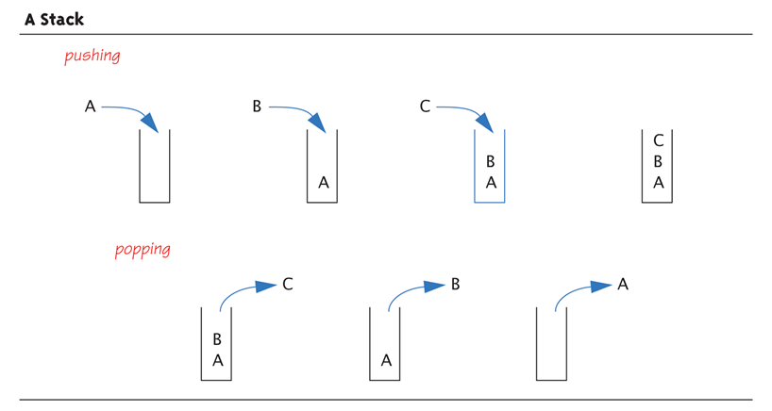
A Stack—Graphic:
Display 17.12 A Stack
Copyright © 2012 Pearson Addison-Wesley. All rights reserved.
17-<number>

Slide 30
Stack Push and Pop
Adding data item to stack → push
  Considered "pushing" data onto stack
  Recall: goes to "top" of stack
Removing data item from stack → pop
  Considered "popping" item off stack
  Recall: removed from "top" of stack
Copyright © 2012 Pearson Addison-Wesley. All rights reserved.
17-<number>

Slide 31
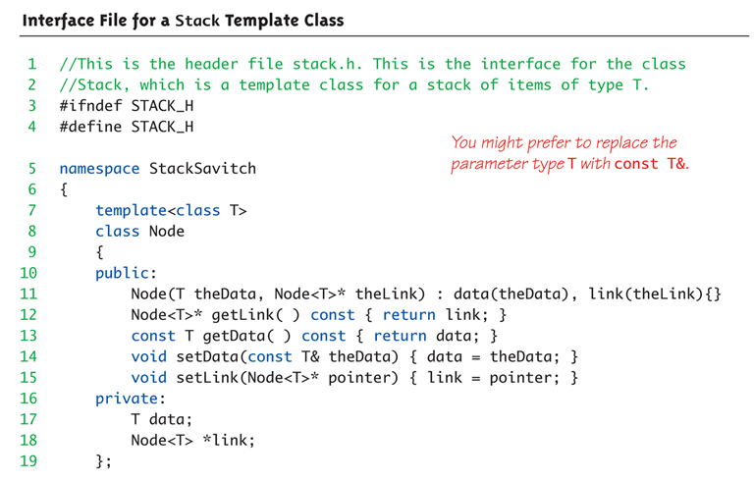
Display 17.17 Interface File for a Stack Template Class (1 of 2)
Copyright © 2012 Pearson Addison-Wesley. All rights reserved.
17-<number>

Slide 32
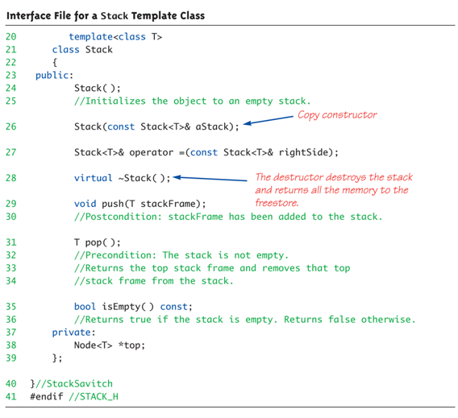
Display 17.17 Interface File for a Stack Template Class (2 of 2)
Copyright © 2012 Pearson Addison-Wesley. All rights reserved.
17-<number>

Slide 33
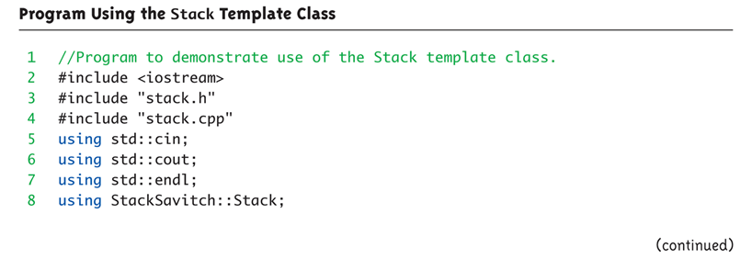
Stack Template Class Driver:
Display 17.18 Program Using the Stack Template Class (1 of 3)
Copyright © 2012 Pearson Addison-Wesley. All rights reserved.
17-<number>

Slide 34
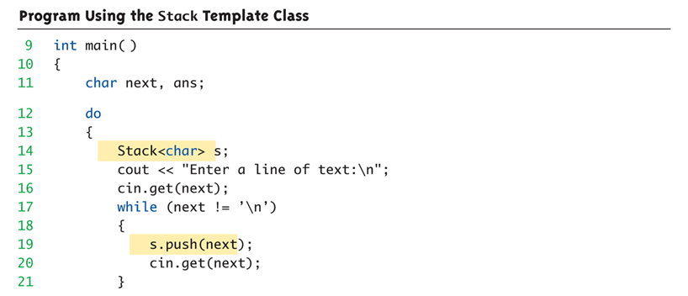
Stack Template Class Driver:
Display 17.18 Program Using the Stack Template Class (2 of 3)
Copyright © 2012 Pearson Addison-Wesley. All rights reserved.
17-<number>

Slide 35
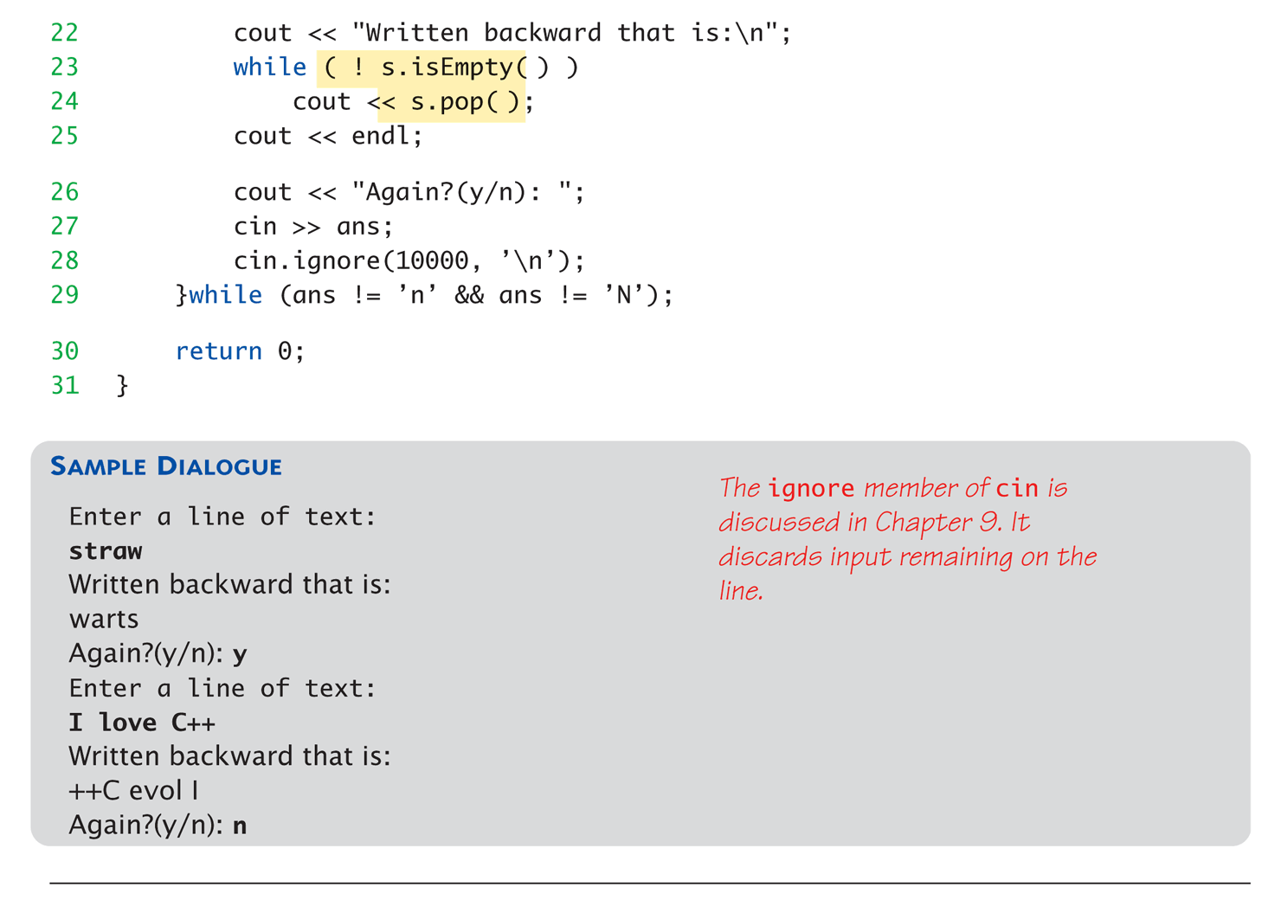
Stack Template Class Driver:
Display 17.18 Program Using the Stack Template Class (3 of 3)
Copyright © 2012 Pearson Addison-Wesley. All rights reserved.
17-<number>

Slide 36
Queues

Slide 37
Queues
Another common data structure:
  Handles data in first-in/first-out manner
  (FIFO)
  Items inserted to end of list
  Items removed from front
Representation of typical "line" forming
  Like bank teller lines, movie theatre
  lines, etc.
Copyright © 2012 Pearson Addison-Wesley. All rights reserved.
17-<number>

Slide 38
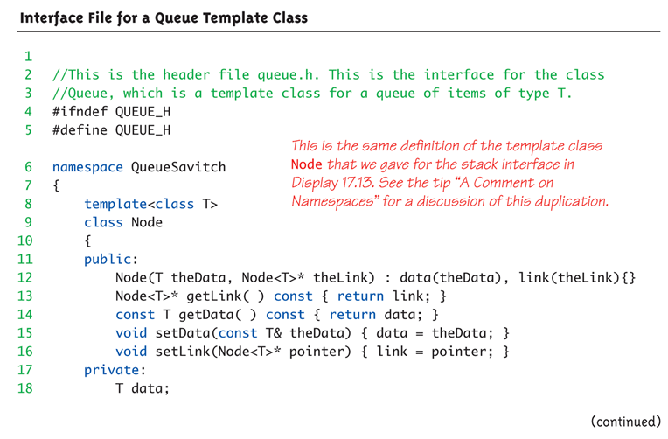
Display 17.20 Interface File for a Queue Template Class (1 of 3)
Copyright © 2012 Pearson Addison-Wesley. All rights reserved.
17-<number>

Slide 39
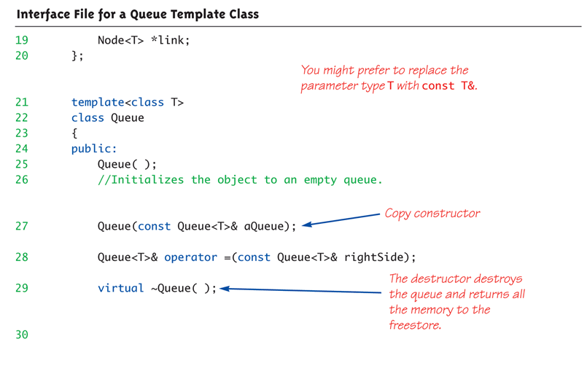
Display 17.20 Interface File for a Queue Template Class (2 of 3)
Copyright © 2012 Pearson Addison-Wesley. All rights reserved.
17-<number>

Slide 40
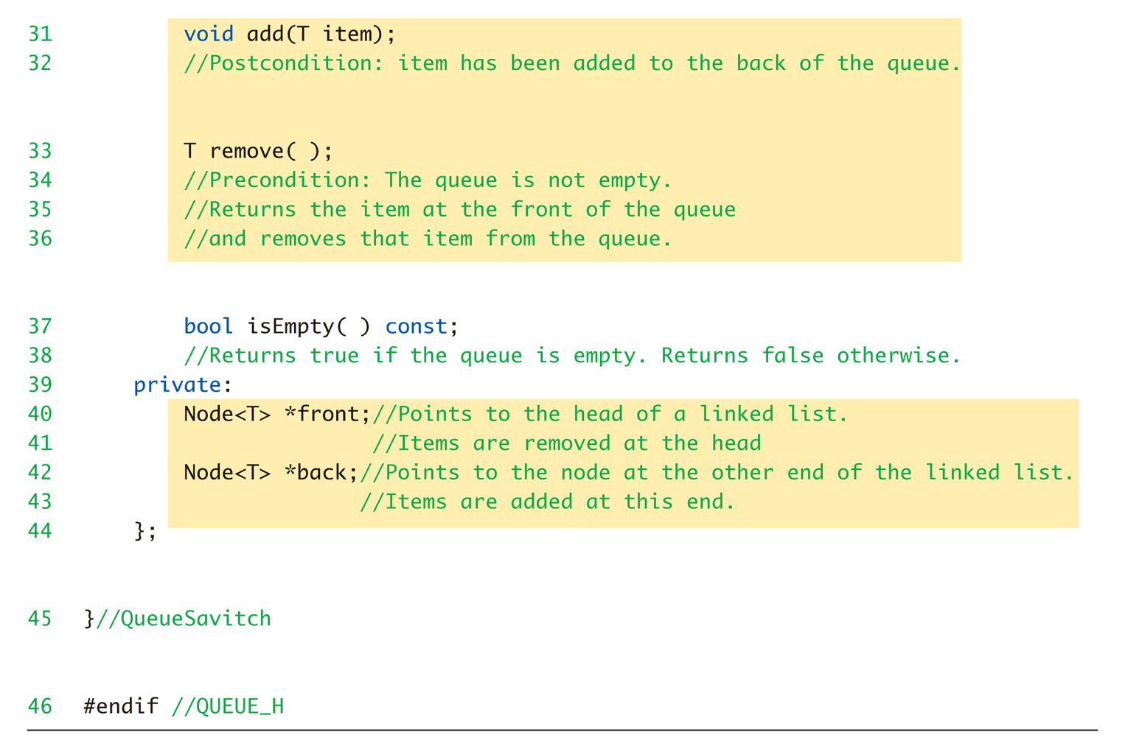
Display 17.20 Interface File for a Queue Template Class (3 of 3)
Copyright © 2012 Pearson Addison-Wesley. All rights reserved.
17-<number>

Slide 41
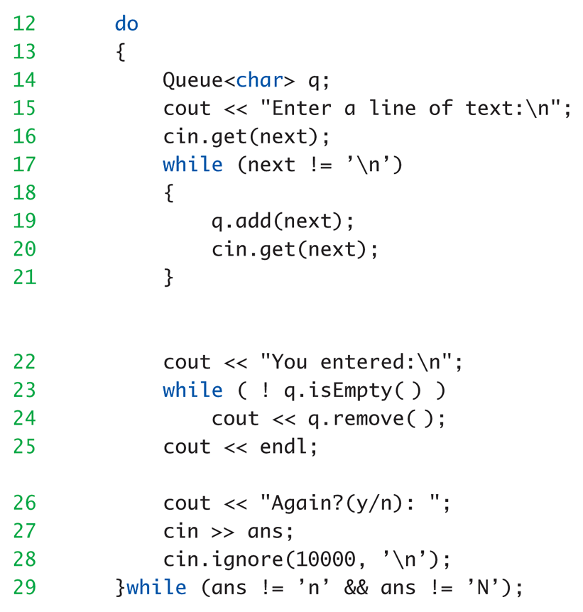
Queue Template Class Driver:
Display 17.21 Program Using the Queue Template Class
Copyright © 2012 Pearson Addison-Wesley. All rights reserved.
17-<number>

Slide 42
Vectors

Slide 43
Vector Class Member Functions and Operators
Vector Class Member Functions and Operators
Selected Vector Functions -
vector(int size) Constructor. Argument size is optional but recommended. Note lower case v.
int .size() Returns the number of elements in the vector.
bool .empty() Returns true only if there are no elements in the vector.

Slide 44
Vector Class Member Functions and Operators
void .push_back(Vector_type value) Puts value into a new storage location created at the end of the vector.
void .pop_back() Removes the last element from the vector and discards it.
void .resize(int newsize, Vector_type value) Resizes the vector. If newsize is less than the current size the vector is truncated. If newsize is larger than the current size the vector is enlarged by adding new elements after the last existing elements. These new elements are set to value if one is provided.

Slide 45
iterator .begin() Returns an iterator that points to the first element of the vector.
iterator .end() Returns an iterator that points immediately beyond the last element of the vector.
int .insert(iterator location, Vector_type value) Inserts value into the vector at the specified location and returns the location.
int .erase(iterator location) Removes the element at location from the vector and returns the position of the removal.
void .clear() Removes all elements from a vector.
void .swap(vector v) Interchanges the elements of the current vector and v. This operation is generally more efficient than an individual swapping of elements.

Slide 46
Remove an element from a vector
int main()
{
static const char letters[] = "ABCDEFGHIJ";
char ch;
vector<char> alphas;
vector<char>::iterator iter;
//Create a vector
for( int i=0; i < 10; i++ ) {
alphas.push_back( letters[i] );
}
//Display the vector
for (iter = alphas.begin(); iter != alphas.end(); ++iter) {
cout << *iter;
}
cout << endl;

Slide 47
while (1) {
cout << "Which letter you want to delete (Quit-*)?";
cin >> ch;
if (ch == '*')
return 0;
iter = alphas.begin();
while( iter != alphas.end() )
{
if (*iter == ch)
iter = alphas.erase( iter );
else
++iter;
}
//Display the vector
…..

